Slide 1
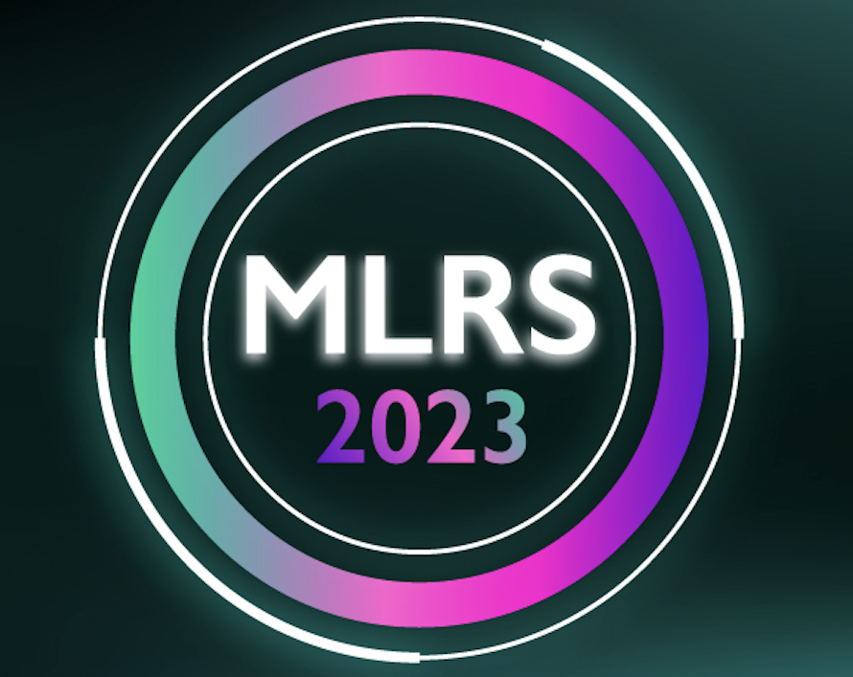
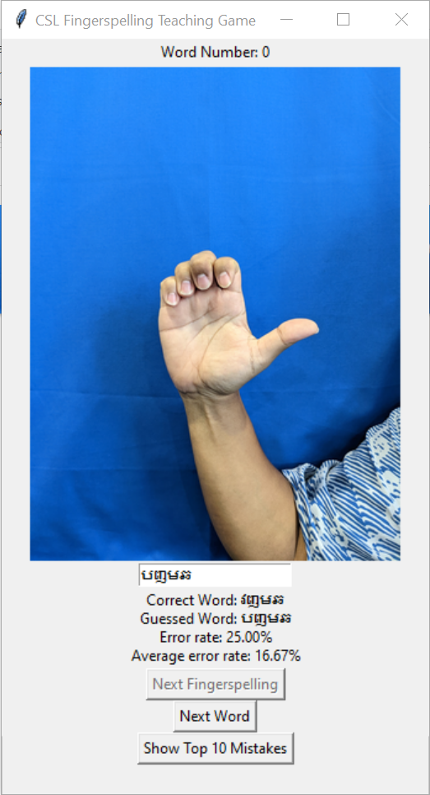
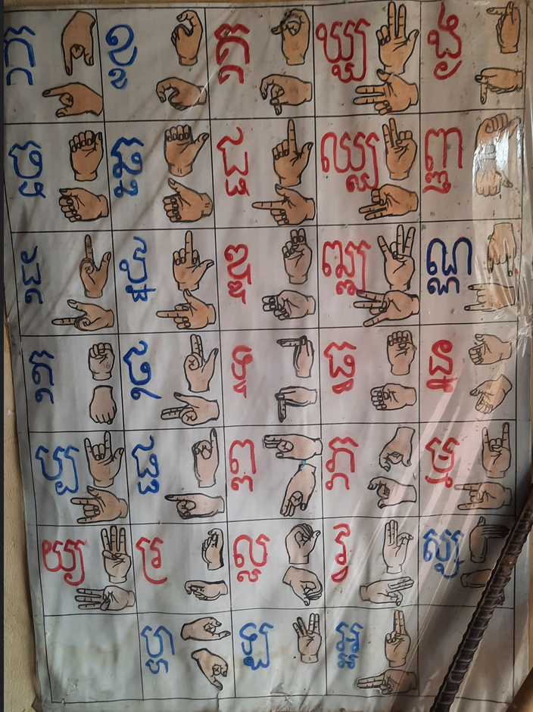
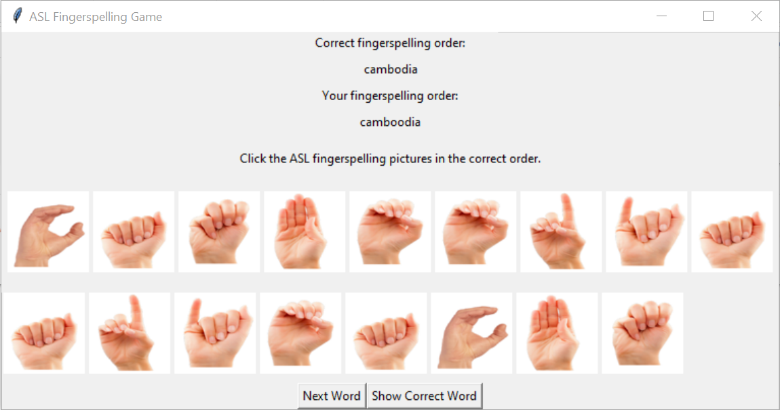
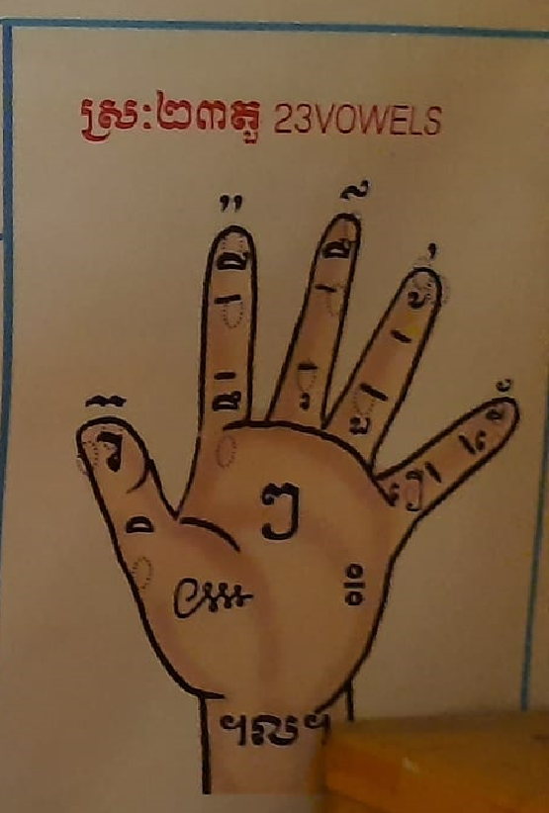
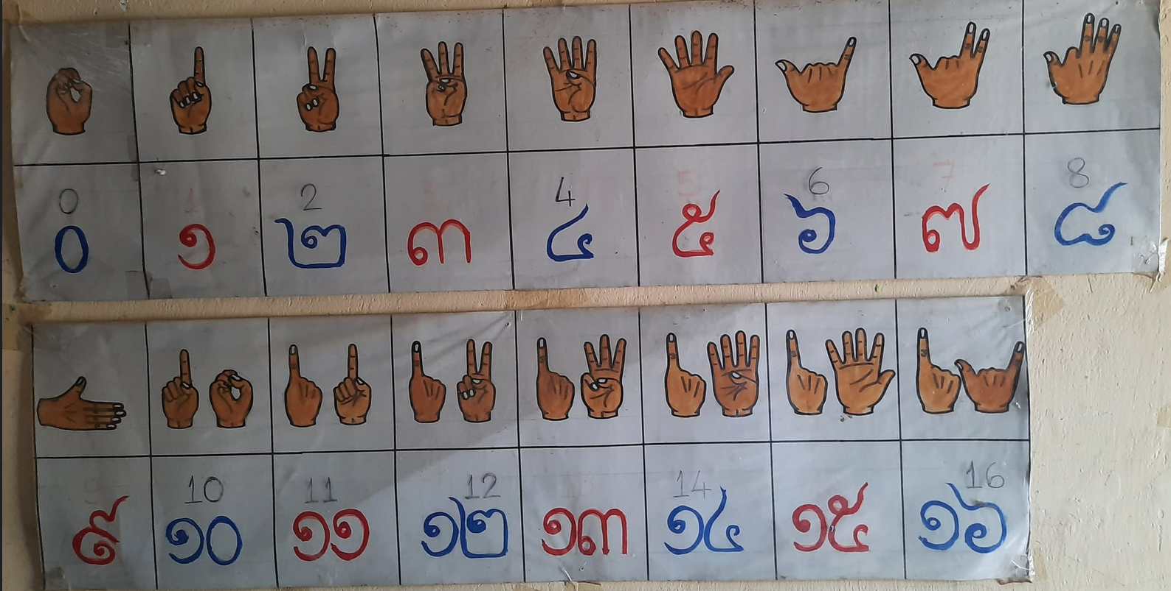
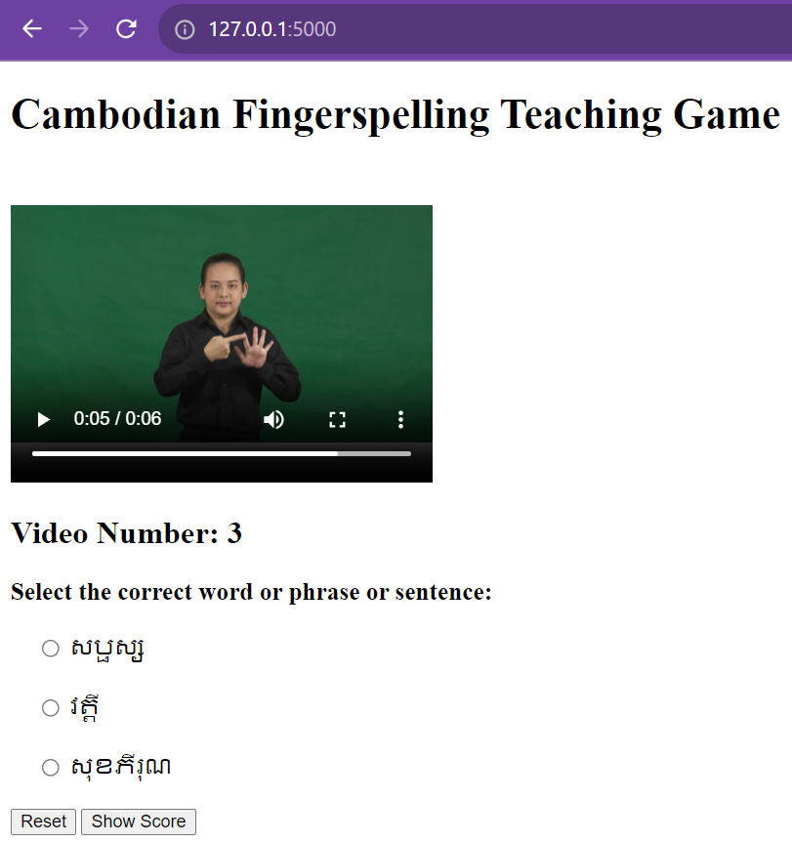
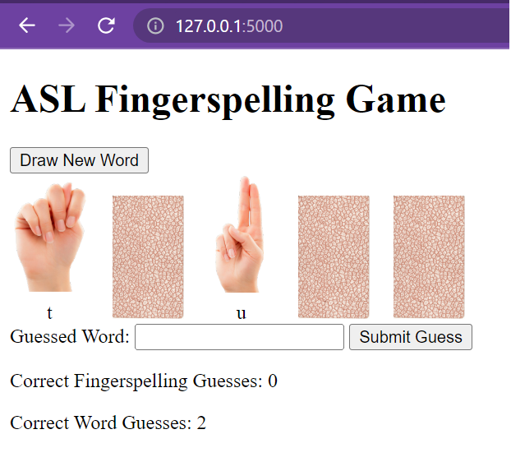
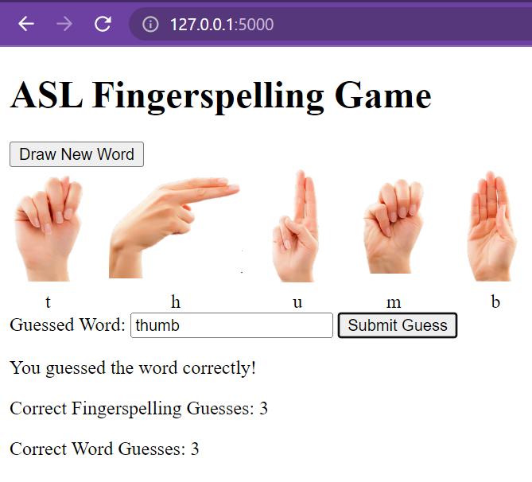
ChatGPT-Assisted Development of
Cambodian Fingerspelling (CFS) Educational Software
Ye Kyaw Thu*†, SOEUM Zera‡, OENG Mengthong‡, KONG Phutphalla†‡
*National Electronics and Computer Technology Center (NECTEC), Pathumthani, Thailand
†Cambodia Academy of Digital Technology (CADT), Phnom Penh, Cambodia
‡Institute of Technology of Cambodia (ITC), Phnom Penh, Cambodia
Abstract
Prompt Engineering
More Game Examples for CFS & ASL Alphabet
Educational software tools must serve all learners, including those with disabilities in developing nations such as Cambodia. A particular challenge for students with hearing impairments is fingerspelling, a critical aspect of sign language education. Our research harnesses the power of ChatGPT, an advanced language model, to create a tool for teaching Cambodian fingerspelling. Despite longer development times due to ChatGPT integration, the benefits it offered in coding and debugging assistance were considerable. This poster outlines our development process, the role of ChatGPT, and the potential of our software in Cambodian fingerspelling education.
Act as a senior programmer, proficient in several programming languages, including Python, experience in game development using tkinter
Act as a web developer, use only HTML, CSS and JavaScript
We conducted experimental developments of Cambodian fingerspelling teaching games using the prompt engineering features of ChatGPT-4. It's important to note that in fingerspelling education, we also teach English fingerspelling to deaf children, typically using the American Sign Language (ASL) alphabet. Below are some additional educational game UI examples for CFS and ASL fingerspelling.
Customized Prompt
Write a python GUI game code. we have a video files under a folder (e.g. video-data), filenames are labels (it can be word, phrase and sentence). Based on the that folder and video files, I want to create a language teaching games. The idea or algorithm of the program is we randomly select the video files from the folder and play that video on GUI interface including play, pause, stop, rewind buttons like in media player program, under the video there will be option buttons together with three labels (including the correct one or the video filename and other twos are other video filenames under the video-data folder) and player have to select the correct label through option buttons. After the player press the "Check" button, the game program will show the correct labels or the current selected video filename. Of course, the game will be looping for showing random videos until the player quit the game. Can you write that Python GUI code?
Cambodian Fingerspelling
Figure 4. Word Guessing Game User Interface for CFS
Figure 1. Cambodian Fingerspelling: Consonants
After Several Attempts
Figure 5. An example of a game UI for teaching the ASL alphabet spelling
Figure 2. Left: Vowels signs; Right: Number signs
Figure 6. A card game UI for teaching the ASL alphabet spelling
Introduction to ChatGPT
Conclusion
ChatGPT, introduced by OpenAI on November 30, 2022, is a chatbot built on a transformer model. It excels in interactive conversations, adjusting to users' preferences in discussion style, question format, and guidance with prompts.
By fine-tuning these prompts, developers can steer the AI to produce accurate code responses, harnessing the model's deep knowledge to craft exact code solutions based on the context given.
For this experiment, we utilized ChatGPT-4, a model exclusively available to Plus users.
Figure 3. An example of a web-based game for Cambodian fingerspelling teaching
We've been developing Python games to teach Cambodian fingerspelling to deaf children. Through this ongoing research, we found ChatGPT invaluable for coding and debugging. Key findings include:
Direct code references often work better than detailed explanations in English.
While ChatGPT aids in correcting code, it can sometimes introduce new errors.
Splitting prompts enhances interaction due to ChatGPT's sentence limitations.
ChatGPT's interactive nature proves more efficient than traditional online debugging searches.
What we learned – Generally, ChatGPT-4 can provide draft code overviews, which include import functions and recommended libraries. However, please consider the following:
The model might introduce some logical errors.
Detailed instructions are required (i.e., prompt engineering).
Avoid asking ChatGPT to resolve multiple issues simultaneously; addressing one error at a time is more effective.
Contact
References
Ye Kyaw Thu
LST, NECTEC, Thailand
Email: yekyaw.thu@nectec.or.th
Homepage: https://sites.google.com/site/yekyawthunlp/
GitHub: https://github.com/ye-kyaw-thu
ChatGPT4: https://chat.openai.com/
Krousar Thmey Khmer Sign Language Dictionary (2013): http://ijs.92.dico.free.fr/dictionnaire_langue_signes_sign_language_khmer_cambodge/khmer/index.html
American Sign Language Alphabets: https://deafchildren.org/wp-content/uploads/2019/07/ASL-Alphabet-ASDC.pdf
NISE Cambodian Sign Language Dictionary: https://kt-slls.geekho.asia/

